Slide 1
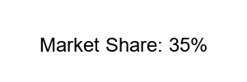
Product Comparison
Our products lead the market

